Slide 1

2026 Indiana Youth Survey
Funding for the Indiana Youth Survey provided by Indiana Family and Social Services Administration’s Division of Mental Health and Addiction.

Slide 2
What is the Indiana Youth Survey (INYS)?
A self‐reported adolescent survey administered in Indiana schools.
Funded by the Division of Mental Health and Addiction in the spring of every other year (even years)
Ask students questions about their…
Alcohol, tobacco, and other drug use
Mental health
Individual beliefs about drug use and antisocial behavior
Family, peers, school, and community environment
Gambling behaviors

Slide 3
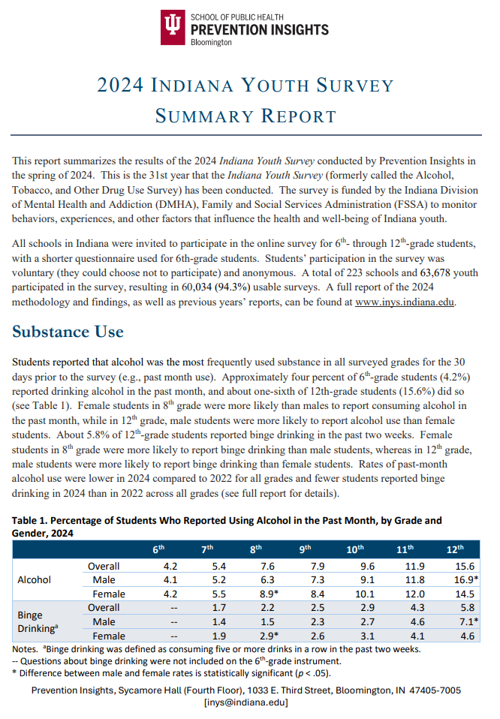



Indiana Youth Survey (INYS)
Notes:
Funded by DMHA
Since 1991
Name change
Changed over time
Website
Statewide reports on website

Slide 4
What Do Schools Get?
Free report for each school corporation
Trend data for schools that participate over multiple years
Publicly available statewide data for comparison
Option to purchase individual school reports

Slide 5


House Enrolled Act 1447
Parental Consent/Notification
Guidelines
Sample letter

Slide 6

Parental Consent: House Enrolled Act 1447
Participating school must notify the parents/caregivers of students.
The first notification
At least 31 days prior to give the survey to students
Letters/emails must be sent to the home of each student
Post the survey instrument on the school’s website

Slide 7
Parental Consent: House Enrolled Act 1447
The second notification
21 days after the first notification
Letters/emails must be sent to the home of students who have not returned parental consent

Slide 8

Parental Consent: House Enrolled Act 1447
Survey administration
10 days after the second notice
Track the students whose parents/caregivers did not allow them to participate in the survey
Provide alternative activities to these students

Slide 9
Changes to 2026 INYS
Marijuana → Marijuana/Cannabis
Smokeless tobacco now includes “pouches”
Alcohol now includes hard liquor and seltzer
Sources of vaping products added
Various consequences of substance use added (not sleeping, poor hygiene, etc.)
Two questions on bullying added
One question on social media use added

Slide 10




2026 Optional Modules
Mental Health (14 items)
Bullying (13 bullying items and 13 cyberbullying items)
Social Media Use (23 items)

Slide 11



2026 INYS
Incentives for randomly selected schools for the statewide probability sample
Spanish Translation
15.9% Hispanic students in the 2024 INYS
+

Slide 12




Recruitment
Letters/emails/postcards
Call school principals
Recruitment materials (i.e., flyers, PPT files) on the INYS website

Slide 13
Recruitment
Focus on benefits of participating in the Indiana Youth Survey
Access to previous reports
Build epidemiological data (trend over time)
Identify local risk and protective factors
Program evaluation
Grant proposal

Slide 14
Responses from Schools
“Unfortunately, with HB 1447, the administration of a 3rd party survey would be a nightmare. For that reason, we will not be participating in this survey.”
“Regrettably, we have a district policy where we are not surveying students anymore and so we cannot participate in the survey.“
“We appreciate your work in this regard and wish this wasn't so
problematic on our end. We can't participate this year. I am curious if
this bill will affect a lot of schools giving the survey.”

Slide 15
Registration
223 schools (just over 60,000 students) participated in 2024
As of this morning,
84 schools have registered (20 randomly selected schools)
Schools opting to include optional modules
Mental Health: 62 schools (73.8%)
Bullying: 53 schools (63.1%)
Social Media Use: 66 schools (78.6%)

Slide 16
2026 INYS Timeline
Invitation letters are sent to schools
Registration closes
Receive report of survey results from Prevention Insights
May 2025
January 31, 2026
January 26 through April 17
August 31
Registration opens
Choose dates to administer the survey and return them to Prevention Insights

Slide 17
Frequently Asked Questions

Slide 18
Is the survey really anonymous?
No identifying questions (name, email)
IP addresses NOT collected
School reports stratified by grade and gender when there are a sufficient number of respondents to ensure anonymity.
If students are concerned about using a school-issued device, refer to your corporation’s policy on student device monitoring.
Notes:
Survey participants are not asked identifying questions (name, email address).
IP addresses are NOT collected by the survey tool.
School and district reports are only stratified by grade and gender when there are a sufficient number of respondents to ensure anonymity.
If students are concerned about the anonymity of their responses when using a school-issued device, refer to your district’s policy on student device monitoring.
Survey participants are not asked identifying questions (name, email address).
IP addresses are NOT collected by the survey tool.
School and district reports are only stratified by grade and gender when there are a sufficient number of respondents to ensure anonymity.
If students are concerned about the anonymity of their responses when using a school-issued device, refer to your district’s policy on student device monitoring.

Slide 19
What if parents are telling us they don’t want their kids to participate?
Any parent can opt their child out
Easy given new consent guidelines
Transparency = clear deadlines, preview survey tool
Identify someone parents can contact with questions and concerns
Contact Prevention Insights for back-up
Notes:
Any parent can opt their child out of participating in the Indiana Youth Survey!
Opting out is easy given new consent guidelines.
School may stress the transparency of their consent process, provide clear deadlines for opting out, and make sure concerned parents can preview the survey tool.
We recommend identifying someone at the school or district level that parents can contact with questions and concerns. Don’t hesitate to contact the Prevention Insights INYS team if you are not sure how to respond.

Slide 20
Will INYS results make our school or community look bad?
Corporations receive their survey report and choose whether to share
Comparing local results with state- and region-level results can reflect positives and negatives
Notes:
Districts and schools receive their data and choose who to share it with; they are not released to the public.
Districts can compare state and region data to their local results
Schools can expect to see “good” results (e.g., local youth use substances at lower rates than their peers in the state of Indiana) in addition to “bad”

Slide 21
What if our local school administrators just “don’t want to know”?
Remind them that:
Most surveyed behaviors happen outside of school
Peer, family, and community challenges impact learning and academic success.
Schools that “know” this can advocate for supportive services and policies
Notes:
Not knowing might seem the easy path; if a school “doesn’t have a problem”, it does not need to make changes.
Remind your administrators that:
Only a handful of items on the INYS relate to what students do in the school building, during the school day. Most of what is covered happens outside of the school’s control and responsibility.
Nonetheless, students bring peer, family, and community challenges INTO the classroom, negatively impacting learning and academic success.
Schools have an interest in knowing what their students are facing in order to advocate for supportive services and policies to ensure their students can succeed.

Slide 22
How can I advocate for INYS participation?
Know if your school has registered
Identify your best contact at the school
Seek partners to encourage school’s participation
Understand and be able to discuss the benefits of INYS participation
Communicate what you will do to support (e.g. assist with administering, interpreting results).
Contact Prevention Insights
Notes:
Know if the school corporation has registered for the upcoming survey.
Determine who would be the best person at the school to discuss the INYS.
Seek other community and school supports to encourage school personnel’s interest.
Understand and be comfortable discussing the benefits of INYS participation with the school.
Be ready to share specific tasks you will do to support the school’s participation (e.g., assisting with survey administration, interpreting results).
Contact the INYS team with any remaining questions or concerns.

Slide 23
Who can help me advocate for INYS participation?
Local Coordinating Council (LCC) or drug free coalition
DMHA prevention grantee(s) in your county or region
Mental health providers, social workers
Grassroots organizations
Youth councils, youth organizations
School board member or trustee
PTO/ PTA
Other ideas???
Notes:
Local Coordinating Council (LCC), which should include representatives from prevention, treatment, and law enforcement sectors. Might be called “Drug Free ___ County”
Other existing local coalitions, e.g. Systems of Care
DMHA prevention grantee(s) in your county or region
Mental health, addictions, and social work providers, some may already provide school-based services or counseling
Grassroots organizations, neighborhood organizations
Youth councils or youth organizations
Contact your school board member or trustee
Other ideas?

Slide 24
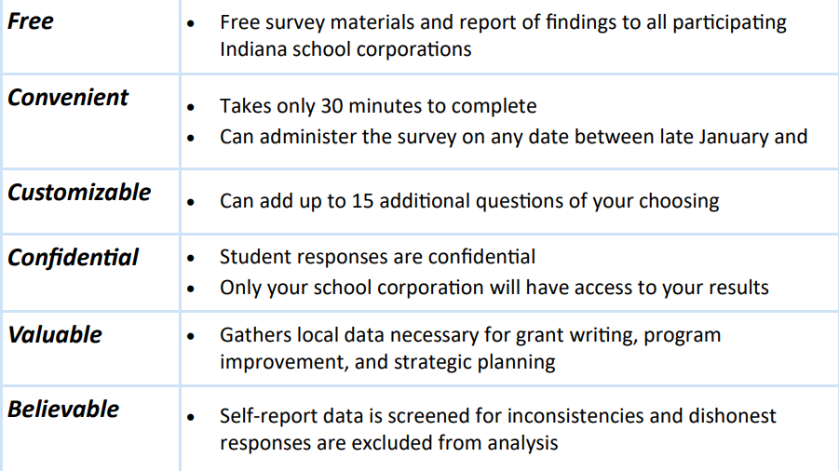
INYS Benefits Talking Points

Slide 25
How can we use our INYS data?
Suggestions:
Convene an internal review committee (schools)
Partner with community-based organizations or coalitions
Share data with prevention and treatment providers
Needs assessments, grant writing, data-driven planning
Contact Prevention Insights
Notes:
Suggestions:
Internal review committee to identify trends from district, school reports
Partner with community-based organizations or coalitions to review and communicate trends (infographics, social norms campaigns)
Contribute insights to local needs assessments, prevention and treatment services
Contact Prevention Insights with survey interpretation questions or for data analysis and visualization, data-driven planning, grant writing, and evaluation support.
inys@indiana.edu
TAHelp@indiana.edu
Become a data champion!

Slide 26
How do I know if my school(s) has signed up to participate?
Contact Information
Mikyoung Jun
mkjun@iu.edu
inys@iu.edu
https://inys.indiana.edu/

Slide 27
Q & A from participants

